Slide 1
ECSC 325.200
Web Server Administration
Spring 2025 - Week 11-1 – March 25th, 2025
More Cloud Stuff
Prof. Jason Patalon

Slide 2

Weekly Info
“No act of kindness, no matter how small, is ever wasted.” - Aesop
Attendance…
Assignment 10 due this week?
  Email updates, FTP install, NFS mount…
Good of the class
  Coronavirus
    Stay safe, wash your hands, don’t touch me, quit putting stuff in your mouth.
  Final Exam
    300 Points
      Hands-on: 40 points (similar to many assignments)
      Short/long answer: 260 points (similar to midterm)
    Tuesday April 29th, 2025
    5:00PM – 7:00PM

Slide 3

Recap and Review
The next few weeks…
  File transfer services
  Security and authentication
  Network Services
  Monitoring and performance tuning
  Cloud
Corrections, updates, etc.
  Update to our configs – coming later!
Questions from previous classes?
Assignment 11 Available – Web stats, backups, DB configs
  Due next week
    April 2nd, 2025

Slide 4
Remaining Semester Topics*
File Transfer Services
  FTP
  SCP, SFTP, RSync
  NFS, CIFS, SMB
Network Functions
Security
  HTTP Authentication
  HTTPS/SSL
  Firewall
  SELinux
  Public Key Cryptography
Monitoring
Backups
Performance Tuning
Cloud
Documentation and Config Management
Work Time?
Final Exam – April 29th, 2025
* Exact topics may change

Slide 5

Objectives
Assignment reviews
Virtualization
Intro to Cloud
Amazon Web Services
Network Configurations
Notes:
Easy may be relative…

Slide 6
Semester Grades Review
Grades are assessed according to the following breakdown:
Description Percentage Total Points Graded points Remaining Points
Midterm Exam 21.42% 300 300 0
Final Exam 21.42% 300 0 300
Attendance 17-28 6.00% 84 48 36
Assignments 9-14 51.14% 716 331 385
Total 100.0% 1300 679 721
  Assignment 14 – 150 Points, more detail & input expected!
  Final – 300 Points – Hands on configuration portion (40 points), mostly 2nd half content
  Not including today’s attendance points
Bonus assignment
AWS – 50 points

Slide 7

Assignment 9 Review
Remove sendmail, install postfix, configure the settings listed, start postifx, and set to start on boot.
Week 7
  Remove sendmail and install postfix & telnet
    dnf -y remove sendmail
    dnf -y install postfix telnet
  Configure Postfix – MTA
    Edit the following lines in the file /etc/postfix/main.cf
      myhostname = ##.megastuff.biz
      mydomain = ##.megastuff.biz
      myorigin = $mydomain
      mydestination = $myhostname, localhost.$mydomain, localhost, $mydomain
      mynetworks = 127.0.0.0/8
      home_mailbox = Maildir/
  Start and enable postfix
    systemctl start postfix.service; systemctl enable postfix.service

Slide 8
Assignment 9 Review
Install Dovecot, configure the settings listed, start Dovecot, and set to start on boot.
Week 7
  Install dovecot
    dnf –y install dovecot
  Configure Dovecot
    Edit file /etc/dovecot/dovecot.conf
      protocols = imap pop3 lmtp
    Edit file /etc/dovecot/conf.d/10-mail.conf
      mail_location = maildir:~/Maildir
    Edit file /etc/dovecot/conf.d/10-auth.conf
      disable_plaintext_auth = no
      auth_mechanisms = plain login
3 different
files to edit!

Slide 9
Assignment 9 Review
Install Dovecot, configure the settings listed, start Dovecot, and set to start on boot.
Week 7
  Edit file /etc/dovecot/conf.d/10-master.conf
    near line 100:
        unix_listener auth-userdb {
        #mode = 0666
        user = postfix
        group = postfix
        }
  Start and enable Dovecot
    systemctl start dovecot.service
    systemctl enable dovecot.service

Slide 10
Assignment 9 Review
Install SquirrelMail and configure the settings listed
Week 7
  Install EPEL and SquirrelMail
      rpm -Uvh https://dl.fedoraproject.org/pub/epel/epel-release-latest-7.noarch.rpm
      yum -y install squirrelmail
  Configure SquirrelMail
    Edit /etc/httpd/conf.d/squirrelmail.conf
      Add a new alias before the /webmail alias:
          Alias /squirrelmail /usr/share/squirrelmail
      Comment out 3 Rewrite lines – disable HTTPS
          # RewriteEngine on
          # RewriteCond %{HTTPS} !=on
          # RewriteRule (.*) https://%{HTTP_HOST}%{REQUEST_URI}
    Restart Apache to apply new configuration changes
      systemctl restart httpd.service

Slide 11
Assignment 9 Review
Install SquirrelMail and configure the settings listed
Week 7
  Run SquirrelMail initial configuration script
    cd /usr/share/squirrelmail/config
    ./conf.pl
      Option 1 – Organization Preferences
        Change Organization Name to use your full name!
        Return to main menu after making change!
      Option 2 – Server Settings
        Change domain to megastuff.biz
      Save and Quit!
  Test SquirrelMail – Log in with your local server account
    http://ecsc325-1##.cs.edinboro.edu/webmail

Slide 12
Assignment 9 Review
Install Roundcube and configure the settings listed
Week 7
  Download specific version
      mkdir /tmp/roundcube
      cd /tmp/roundcube
    wget https://github.com/roundcube/roundcubemail/releases/download/1.6.10/roundcubemail-1.6.10-complete.tar.gz
  Uncompress tarball archive
      tar zxvf roundcubemail-*.tar.gz
  Move roundcube directory to /var/www directory and create a symbolic link
      mv roundcubemail-1.6.10 /var/www/
      cd /var/www
      ln -s ./roundcubemail-1.6.10 ./roundcube
  Set ownership & permissions
      cd /var/www/roundcube/; chmod -R o-rwx ./
      chmod -R ug+rwX ./temp ./logs; chown -R root:apache ./

Slide 13
Assignment 9 Review
Install Roundcube and configure the settings listed
Week 7
  Set up Roundcube database
      mysql -u root -p
        CREATE DATABASE roundcubemail /*!40101 CHARACTER SET utf8 COLLATE utf8_general_ci */;
        GRANT ALL PRIVILEGES ON roundcubemail.* TO roundcube@localhost IDENTIFIED BY 'password';
        quit;
      mysql –u root roundcubemail < SQL/mysql.initial.sql -p
      chmod -R ug+rwX ./temp ./logs; chown -R root:apache ./
  Create new virtualhost file at /etc/httpd/conf.d/roundcube.conf
      <VirtualHost *:80>
      ServerName roundcube.##.megastuff.biz
      DocumentRoot "/var/www/roundcube"
      </VirtualHost>

Slide 14
Assignment 9 Review
Install Roundcube and configure the settings listed
Week 7
  Fix our PHP settings - Make sure timezone is configured correctly in php.ini file!
      echo 'date.timezone = "America/New_York"' >> /etc/php.ini
  Restart apache & php-fpm!
      systemctl restart httpd && systemctl restart php-fpm
  Point your browser to http://roundcube.##.megastuff.biz/installer
  Follow the instructions of the install script
    Make sure all required components are installed on page 1 “Check Environment”
    Enter password for database user created in previous slide on page 2 “Create Config”
      My password was password
    Copy the config text from the installer to the file /var/www/roundcube/config/config.inc.php
      Make sure to add at the end of the file:
      $config['smtp_user'] = '';
      $config['smtp_pass'] = '';
      $config['smtp_host'] = 'localhost:25';
      ?>

Slide 15
Assignment 9 Review
Install Roundcube and configure the settings listed
Week 7
  Test SMTP config
    Sender: yourusername@##.megastuff.biz Recipient: yourusername@##.megastuff.biz
  Test IMAP config
    Username: yourlocalusername Password: yourlocalpassword
  After creating and testing the configuration, remove the installer directory
      rm –rf /var/www/roundcube/installer
  Set up a cronjob to run cleanup daily as the root user
      crontab -e
      0 0 * * * /var/www/roundcube/bin/cleandb.sh
  Log in!
    http://roundcube.##.megastuff.biz

Slide 16

E-Mail Services Check
Create E-Mail forward for user jpatalon
  Edit the file /home/jpatalon/.forward
  Enter on one line by itself, email address to forward to
    jpatalon@pennwest.edu
Send an email from RoundCube to jpatalon@##.megastuff.biz
  Email will be sent to local account and forwarded. Include your name in the email message!
Send email to your username@##.megastuff.biz from RoundCube
  Email should show up in your Roundcube Inbox!
  Don’t delete it!
Run assignment 9 check script
  http://jpatalon.cs.edinboro.edu/ecsc325/classfiles/assignment9check.sh
  Don’t forget to set script executable before running!

Slide 17
Cloud Computing
The on-demand availability of computer system resources, with a level of abstraction from direct user interaction
  Depending on the cloud service, you may have different levels of access
  The provider can offer services at multiple levels
  Geographically different locations for availability
    Eastern US, Western US, Europe, Asia, etc.
  Typically a pay per use model
    $0.10/hour ≈ $70/month
  Amazon started AWS in 2006
    Others followed, such as Google, Microsoft, and others
  Allows users to leverage a large, resilient, fault tolerant
  infrastructure platform with minimal knowledge of the
  underlying hardware and software technologies

Slide 18
Cloud Computing
Several key characteristics identify cloud computing:
  Agility to move and adjust
  Lower cost/barrier to entry
  Reduction of maintenance and overhead costs
  Reliability and scalability
  Enhanced security
  Advanced monitoring, logging, and statistics
Cloud computing can be on or off-premises
  On-prem: A cloud-like environment in your data center
  Off-prem: A cloud-like environment on the internet
Flexibility is key!
Someone else’s datacenter!

Slide 19

Anything as a Service (XaaS)
Infrastructure as a Service – The vendor manages the infrastructure, providing you with a Guest OS that you can manage
  This is what we have on campus – EUP manages all networking, storage, and hardware
  Co-Location – A type of IaaS where you provide the server hardware in their environment
  Typically identified by having full admin/root access to the VM
  Linode, Rackspace, DigitalOcean, Hurricane Electric, AWS, Azure
Platform as a Service – Provides standard software components, providing you a
platform to run your application, store your database, or save your documents.
  The platform handles capacity provisioning, monitoring, package and
  dependency installation, etc.
  You only need to deploy code that fits the stack
  AWS Elastic Beanstalk, Apache Stratos, OpenShift
Software as a Service – The vendor manages everything, you only use the software!
  Google docs, Office 365, Dropbox, Webex

Slide 20
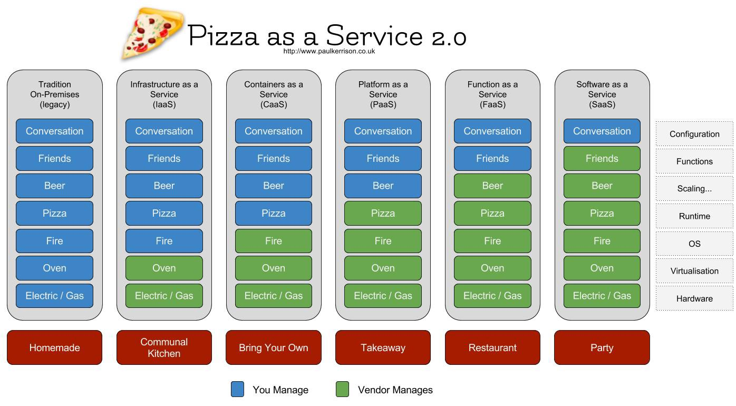

Slide 21
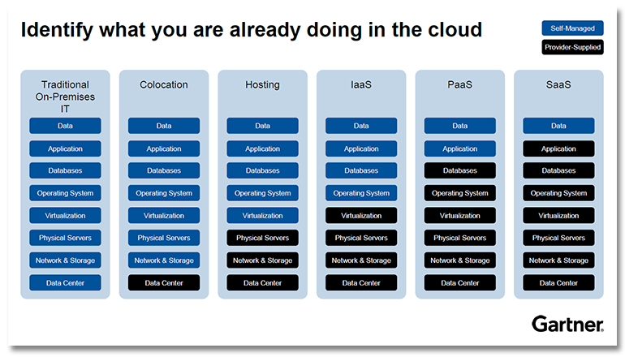

Slide 22

Intro to Amazon Web Services
Started with S3 (Simple Storage Services), expanded to multiple other services
Compute – Various different operating system
  Create your own custom OS images to deploy from
  Virtual Machines!
  Auto Scaling Groups
  Load Balancers
Storage – Multiple types of data storage
  SSD or traditional disks for block storage
  Object storage for video/image files, etc
Database – Relational databases or others (NoSQL)
  Create your own databases or database management systems
  Backups, availability, etc.

Slide 23
Intro to Amazon Web Services
Networking – Create your own logically separate network
  Virtual Private Cloud (VPC) – Separate routes, CIDR masks, subnets, and more
    Encrypted connections possible as a service
  Route 53 – Cloud DNS Management
Many more services!
  Email, messaging, analytics, data analysis, security, utilization, deployment services, mobile services…
Multiple ways to manage your services
  AWS Management GUI Console
  AWS Command Line Interface
  AWS API HTTP Calls
  Various SDK’s for multiple programming languages
  IDE toolkits for Eclipse and Visual Studio

Slide 24
Intro to Amazon Web Services
AWS Regions
  Fairly independent collections of data centers
  within a specific geographic area
    US East, N Virginia, us-east-1
    US West, Oregon, us-west-2
    Asia Pacific, Tokyo, ap-northeast-1
  https://www.cloudping.info/
Availability Zones
  A specific zone within an AWS Region
  Separate datacenters
  Low latency connections between AZ’s
  Provides for fault-tolerant designs
    If an AZ goes offline, you can run on another AZ in that region
Geolocation!

Slide 25
Intro to Amazon Web Services
Benefits and use cases for AWS services
  Faster time to deployment of new applications
  Cloud backup and storage archival options
  Disaster recovery strategies with AWS
    Cold, warm, and hot sites
  Edge locations
    Content delivery networks
    Keep the data cached closer to the end user
  Computationally intense tasks
    You’re only charged while your task runs – typically per hour
      Rate changes depending on what the type/speed/config of VM
    100 Hours on 10 VM’s = 1 hour on 1,000 VM’s
    Save money, especially if tasks are infrequent

Slide 26
Intro to Amazon Web Services
Elastic Compute Cloud (EC2)
  Most common compute service that Amazon offers
  Deploy virtual machines
  AMI’s
    Template of pre-configured EC2 instances
    Can include a base OS and additional applications
    Customized AMI’s and
  Instance Types
    Size of instance: CPU, RAM, Disk, Network, etc.
    Categorized into different families – different types of hardware
      Storage optimized, compute optimized, memory optimized,
      GPU, general use, combination, etc.

Slide 27
Intro to Amazon Web Services
Elastic Compute Cloud (EC2)
  Pricing Options
    On-Demand – EC2 instances that can be launched at any time and kept online as long as you want
      Typically short term or testing
    Reserved – Purchase for a set amount of time (1-3 years) at a discount, with flexible payment options
      Typically long term predictable workloads
    Spot Instances – Bid for unused EC2 compute resources
      Pricing fluctuates based on supply and demand
      Can be suddenly interrupted, may be terminated at any time – 2 minute notice!
  Tenancy – The underlying hosting of your EC2 instance
    Shared – EC2 instances are on any available host
    Dedicated Instances – Instances hosted on that hardware only belong to one customer
    Dedicated Hosts – Additional visibility and control of the physical host, additional compliance
  User Data – Commands to run when the instance first boots
    Update your server, install and configure some packages, reboot, etc.

Slide 28
Intro to Amazon Web Services
Elastic Compute Cloud (EC2)
  Storage Options
    Persistent Storage – Elastic Block Storage (EBS) volumes
      Physically separated from the EC2 instance
      Disconnect and reconnect volume as needed between VM’s
      Encryption and snapshots of data is available
      Logically attached via the AWS network
        NAS, SAN, etc.
    Ephemeral Storage – EC2 storage within the VM itself
      Physically attached to the underlying VM host itself
      Saved data on the disk is lost when the instance is terminated
      Cannot be detached from a server

Slide 29
Intro to Amazon Web Services
Elastic Compute Cloud (EC2)
  Security
    Security Groups - A virtual firewall for your instances
    Key Pairs - Public Key and Private Key used for authentication
      Additional authentication methods can be configured
    OS Patches and security are your responsibility!
  Networking
    Create separate networks
      Private or public networks
    Customized security groups, routes, network configs

Slide 30
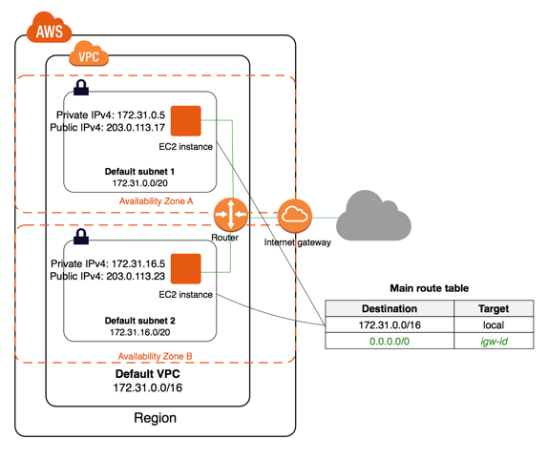
Intro to Amazon Web Services

Slide 31
Intro to Amazon Web Services
Elastic Load Balancer (ELB) – Direct and route traffic to multiple instances
  Classic Load Balancer – Route traffic based on application and network
  Application Balancer – Advanced routing of application specific traffic
  Configure over multiple AZ’s to increase resiliency
  Internal Load Balancer
    Internal IP address, only accessible from within AWS network
  External Load Balancer
    Public IP address
    Receives traffic from the internet and routes to the instances
  Best Practice is to distribute traffic to 2 different AZ’s
  Listener Configuration
    Listens for connection requests to be forwarded
    HTTP, HTTPS, TCP & SSL
      HTTPS or SSL will require an SSL certificate!

Slide 32
Intro to Amazon Web Services
Elastic Load Balancer (ELB) – Direct and route traffic to multiple instances
  Health Checks – Monitor the health of your instances
    If one instance goes offline, the ELB will stop sending it traffic
    Uses a special type of ping
    Configure the number of failures, time, other.
    Security Groups
Auto Scaling – Automatically increase or decrease compute resources
  Add an instance when demand is high, terminate the instance when demand is low
  Automatic infrastructure management
  Better user experience and potential Cost reduction
  Launch Configuration – Template used to launch new instances
  Auto scaling group – Defines group scaling policies and resource locations
ELB will automatically reconfigure with auto scaling!

Slide 33
Intro to Amazon Web Services
EC2 Container Services (ECS) – Run Docker enabled applications packaged as containers
  Run your containers across a cluster of CE2 instances
  Abstracts the cluster management as a service
  Easily create alarms based on ECS metrics
  Additional security group configurations
Docker – Software used to automate the installation and distribution of applications inside containers
Container – Holds everything that an application needs to run within the container package
  Libraries, dependencies, and an application
  Shares the underlying OS kernel
  Decoupled from the OS, providing excellent portability

Slide 34
Intro to Amazon Web Services
EC2 Container Services (ECS) – Run Docker enabled applications packaged as containers
  An ECS cluster is made up of a collection of EC2 instances
  Most instances are the same or extremely similar
  Clusters can act as a resource pool
  Clusters are dynamically scalable
  Multiple instances can be used
  Clusters can only scale within a single region
  Deployments can be scheduled

Slide 35
Intro to Amazon Web Services
AWS Elastic Beanstalk – Automatically provision and deploy the necessary resources within AWS
  Provides a simple and quick solution for scaling
  Elastic Beanstalk is free to use, but you will pay for any resources it creates
  Applications – A collection of different elements, such as environments, configurations, and app versions
  Application Version – A specific reference to a section of deployable code, typically on S3
  Environment – An application version deployed on AWS
  Environment Configuration – A collection of parameters that dictate the resources behavior
  Configuration Template – A baseline for creating a new unique configuration
4 Steps to Elastic Beanstalk application deployment and management
  Create Application
  Upload application version and configuration information
  Launch environment
  Manage the environment

Slide 36
Intro to Amazon Web Services
Web Server Elastic Beanstalk Environment – Typically used for standard HTTP web applications
  Route 53 DNS Services
  Elastic Load Balancing
  Auto Scaling
  EC2
  Security Groups
Worker Elastic Beanstalk Environment – For apps with back-end processing interacting with SQS
  Simple Queue Service (SQS)
  EC2
  IAM Roles
  Auto Scaling

Slide 37
Intro to Amazon Web Services
Elastic Beanstalk - Configuration Options
  Platform selection
    Python, Ruby, Tomcat
  Single or Multiple Instances
    Load balancing and auto scaling options
  Deployment Policy
    Deploy items all at once, or staggard/staged
  Application URL
  Additional Resources
    RDS Database
  Instance Details
    Instance type, size, storage
  Permissions
    Allowing Elastic Beanstalk to access the necessary items

Slide 38
Intro to Amazon Web Services
AWS Lambda – Allows you to run your own code in response to events in a serverless environment
  Serverless means you can run your own code without provisioning and managing compute resources
  AWS will start, scale, maintain, and stop the required resources for your lambda function
    This could be as short as a few milliseconds
  Great for code to be run in response to events
  Execute every time an image is uploaded to an S3 bucket
    Take this image, create a thumbnail, and compress the image
  Node.js, Java, C#, Python
  Charged for compute time to the closest 100ms
  Lambda Function – Contains code to run the tasks, and any dependencies
  Required Resources – Resources necessary (RAM)
  Maximum execution timeout – How long function can run before it is killed
  IAM Role grants AWS Lambda the appropriate permissions
  Handler Name is the method in your code where the function starts

Slide 39
Intro to Amazon Web Services
AWS Lambda – Allows you to run your own code in response to events in a serverless environment
  Triggers must be defined before the code will run
    Can come from another AWS service (S3, DynamoDB, etc)
  Basic AWS Lambda Configuration steps:
    Select a blueprint – Preconfigured templates provided by AWS
      These can be modified to fit your use
    Configure triggers – Define what triggers your Lambda function
      When a certain thing happens, run our function
    Configure functions – Definitions for the Lambda function
      Required resources
      Maximum execution timeout
      IAM Role
      Handler Name
Highly scalable serverless architecture!

Slide 40
Intro to Amazon Web Services
AWS Batch – Used to manage and run batch computing workloads
  Batch Computing is primarily used in special cases where a large amount of compute power is needed
    Typically batch processing consists of a series of jobs to be executed
  Batch computing can require specific hardware or software
  Five effective components
    Jobs – A unit of work to be run by AWS
      Shell script or similar, run on EC2 instances as a containerized application
    Job Definitions – Specific parameters for the jobs
      Number of CPUs, location of data volumes, list of IAM roles, list of mount points
    Job Queues – Where jobs are held until they run
      Multiple queues with different priorities are possible
    Job Scheduling – Takes control of when a job should run and where
      Typically first-in first-out (FIFO), Ensures that higher priority queues are run first
    Compute Environments – Environments with the compute resources
      Managed environment – The service handles provisioning, scaling, and termination
      Unmanaged environment – You maintain the necessary AWS components

Slide 41
Intro to Amazon Web Services
Amazon Lightsail – A Virtual Private Server (VPS) backed by AWS infrastructure
  Resembles EC2, but simpler and easier for small use cases such as simple websites, small applications, or blogs
  Lightsail VPS’s consist of the following components:
    The virtual instance itself
    An Operating System and any optional pre-installed applications
    Storage (SSD)
    Data transfer limits
    DNS Management
    Static IP address
  Used to host You can connect multiple Lightsail instances together,
  and connect to other AWS services from your Lightsail instance
  6 Steps to deploy
    Pick your OS (or OS + app), Add optional launch script, set SSH keys, chose instance plan,
    Choose pricing plan, Select AZ, Name your instance, Create!
  AWS provides metrics, a virtual firewall, snapshot services, and more!

Slide 42
DevOPS
DevOPS – A set of practices that automates the processes between software development and IT teams
  Allows for rapid building, testing, and deployment
    Can deploy new versions of software more often
    Create automated testing and review scenarios
  Manage infrastructure as code
    Git, branching, pull, merge, versioning…
  Key items of DevOPS:
    Culture – A shift from individual silos to cross-team collaboration
    Automation – Remove the possibility of human error, make things repeatable
    Lean – Eliminate low-value activities and move quickly, agility, fail fast
    Measurement – Show increases in efficiency of new processes, identify areas of improvement
    Sharing – Share responsibility between Dev and Ops to grow the teams and increase success rates

Slide 43
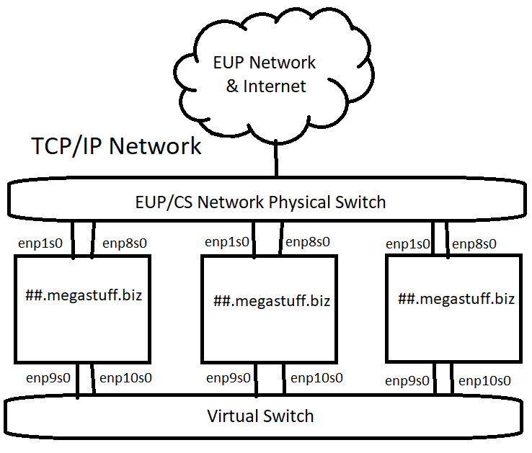
Multiple Network Configurations
Our ##.Megastuff.biz servers have four network interfaces
on two different networks!
  Device enp1s0 & enp8s0 – EUPCS Network
  Device enp9s0 & enp10s0 – Virtual Machine Network
Our virtual machine network only exists within the hypervisor!
  Only VM’s in this cluster can access the virtual switch!
We can use this separate virtual network for
security, administration, backup, or other reasons!
This is network virtualization at the hypervisor layer
Logical vs. Physical
Multihoming – Connecting a device to more than one network

Slide 44
Virtual Network Configurations
We can further virtualize our network traffic using
Virtual Local Area Networks (VLANs)
While all network traffic flows over the same physical
links, VLAN traffic over the virtual switch is tagged
within the infrastructure as a specific network
Different switch ports can be set for different VLANs
A different logical network using existing physical cables
This is virtualization at the interface or guest layer
  The guest can optionally do VLAN tagging
  The switch can force VLAN tagging on specific ports & traffic
Standardize, make repeatable

Slide 45
Assignment 11 Checklist
AWStats should be installed and have:
  Config file at /etc/httpd/conf.d/awstats.conf
  Crontab entry for root user
  Respond to webpage queries
Read assignment 11 and run assignment 11 check script
  http://jpatalon.cs.edinboro.edu/ecsc325/Assignment%2011.pdf
  http://jpatalon.cs.edinboro.edu/ecsc325/classfiles/assignment11check.sh
  Don’t forget to set script executable before running!
  Documentation!
Parts of this assignment - 45 Points
  AWStats configs
  Backups of web files and WordPress database
  MariaDB configuration optimization updates
  System updates and reboot!
Details in
Week 10…

Slide 46
ECSC 325.200
Web Server Administration
Spring 2025 – Week 11-2 – March 27th, 2025
Monitoring, Logging, Firewalling, Virtualizing, Cloud
Prof. Jason Patalon

Slide 47
Objectives
Quick reviews
Network Interface Additions
  VIPs
  VLANs
Disk Additions
  Partitions
  PV’s
  VG’s
  LV’s
  NFS Exports
  NFS Mounts
More…
Notes:
Easy may be relative…

Slide 48
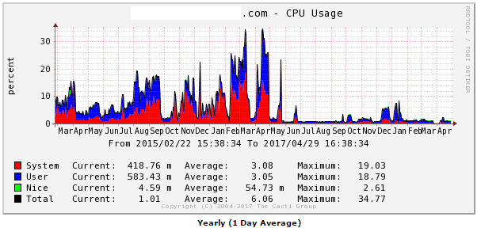
Monitoring Operating Systems
Splunk
  Log file aggregation tool - Organize many different log files into a single searchable interface
    Multiple logs from multiple systems!
  Correlate information between different logs/systems/etc.
Cacti
  Monitor network, CPU, disk space, etc.
  Long-term system monitoring
  Example graph to right →
Naigos
  Similar to Cacti
  Monitor system resources
Netdata
  Real-time short-term system monitoring
Nimbus

Slide 49
Multiple Network Configurations
Our ##.Megastuff.biz servers have four network interfaces
on two different networks!
  Device enp1s0 & enp8s0 – EUPCS Network
  Device enp9s0 & enp10s0 – Virtual Machine Network
Our virtual machine network only exists within the hypervisor!
  Only VM’s in this cluster can access the virtual switch!
We can use this separate virtual network for
security, administration, backup, or other reasons!
This is network virtualization at the hypervisor layer
Logical vs. Physical
Multihoming – Connecting a device to more than one network

Slide 50
Virtual Network Configurations
We can further virtualize our network traffic using
Virtual Local Area Networks (VLANs)
While all network traffic flows over the same physical
links, VLAN traffic over the virtual switch is tagged
within the infrastructure as a specific network
Different switch ports can be set for different VLANs
A different logical network using existing physical cables
This is virtualization at the interface or guest layer
  The guest can optionally do VLAN tagging
  The switch can force VLAN tagging on specific ports & traffic
Standardize, make repeatable

Slide 51
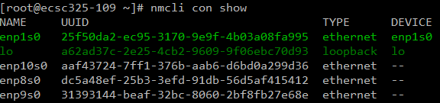
NMCLI Command
Tool used to manage network connection and devices through NetworkManager
  NetworkManager Command Line Interface
nmcli : Show some info about network devices
nmcli device show : Show detailed info about network devices
nmcli device status : Show summary info about network devices
nmcli connection show : Show summary info about connection profiles
nmcli --help
Usage: nmcli [OPTIONS] OBJECT { COMMAND | help }

Slide 52
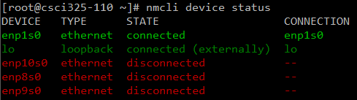
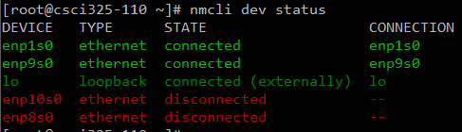
Set up an additional network device
Show our existing devices with nmcli:
  nmcli dev status:
Configure the enp9s0 device with nmcli:
  nmcli con add type ethernet con-name enp9s0 ifname enp9s0 ip4 192.168.187.1##/24
Check it is now connected:
  nmcli dev status:

Slide 53
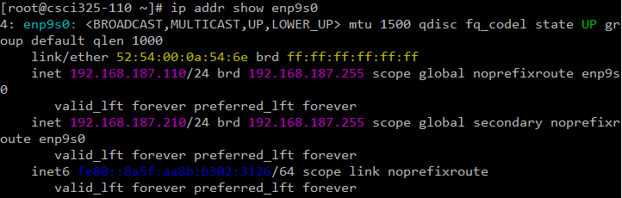
Add a VIP interface
Add an IP address to the interface you just created
  The interface will now have 2 IP addresses!
    nmcli con mod enp9s0 +ipv4.address 192.168.187.2##/24
    nmcli con reload enp9s0
    nmcli con down enp9s0 && nmcli con up enp9s0
  Check that our new IP address exists!
    ip addr show enp9s0
Assignment 11?

Slide 54
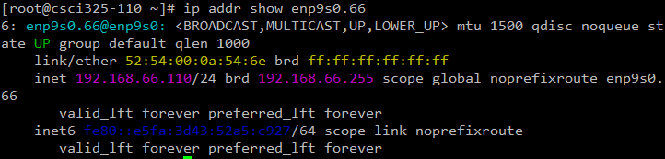
Add a VLAN interface
Create a Virtual LAN network configuration for the device we want to use – VLAN 66
New device enp9s0.66:
    nmcli con add type vlan con-name enp9s0.66 ifname enp9s0.66 dev enp9s0 id 66 ip4 192.168.66.1##/24
Check it:
  ip addr show enp9s0.66

Slide 55
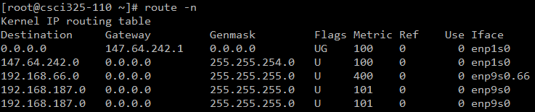
Check our interfaces and routes!
Run the command ifconfig to see all available network interfaces
  We have 2 interfaces running – 1 on the EUPCS network, 1 on the Virtual Network
    Potential failover/fault tolerance?! No!
      Network bonding or teaming?! No!
  We also have the local loopback device lo
    This just lets us talk to ourselves
  Virtual LAN interfaces are also listed
  Run the route -n command to examine our different networks:

Slide 56
File Systems
File systems provide a method of organizing data on a storage media.
The basic building block of most Linux file systems is the i-node
  The i-node is a control structure that either points to data or other i-nodes
  The i-node contains info such as ownership, permissions, access/edit times, and similar.
    It does not provide the file name however!
  Data is broken into blocks
    The smallest amount of addressable data on a device
    A block may contain an entire file, or only part of the file, depending on sizes
    The block size can be specified when creating the file system, such as 1KB
    Blocks are grouped together into block groups
      Block groups contain a copy of the superblock, a descriptor table, the block bitmap,
      an i-node table, and data blocks
  Superblocks are the first piece of data read from a disk
    A small piece of very important information, they contain the disk geometry,
    amount of available free space, and the location of the first i-node

Slide 57
File Systems
Some file systems use Extents instead of i-nodes
  An extent is a means of representing contiguous physical blocks
  Provides information about the next range of blocks
  Instead of pointing to each individual block, the extent
  says the next X blocks belong to a specific data file.
Defragmentation is when these data blocks are spread
out on the disk, with other data blocks in between.
  Traditionally defragmentation was done offline
    Nothing can access the disk, interrupting the defrag process
  Online defragmentation became possible with newer file systems
    Some filesystems allow for defragmentation of individual files
Different file systems have different features
  Online defrag, online disk checking, encryption, RAID functions,
  compression, large disk sizes, various block sizes, deduplicaton…

Slide 58
File Systems
We use the mount command to mount a file system
  We also use the umount command to unmount a system
We define our boot-time mounts in the /etc/fstab file
  Ex: /dev/mapper/centos_ds1019vm-root / xfs defaults 0 0
We can use the fsck tool to diagnose and repair file system issues
  File System Check (fsck) – Similar to Check Disk in Windows
    Can run automatically as scheduled
    Often required on boot after so many days or number of mounts
  Linux typically automatically can repair issues by itself
    Some times critical data may be lost, and the system may not be able to boot
      While you may be able to recover from this, it is often a futile effort
    If fsck finds file segments it doesn’t know what to do with, they will end up in
    the “lost+found” directory of that file system (if supported by the file system)
      Separate mount points would have their own “lost+found” directories

Slide 59
Create a New File System
We have some extra disk space available!
  Our current disk configuration consists of
    A 100GB disk - /dev/vda
      74GB VG allocated to our root volume group (cs)
        50GB LV for our root logical volume (root) – XFS filesystem
        20GB LV for our home logical volume (home) – XFS filesysem
        4GB LV for our swap logical volume (swap) – SWAP Filesystem
      1GB for boot
      25GB free space
    We also have a 10GB disk at /dev/vdb…
  Lets make a 1GB partition on /dev/vdb to add to our VG!
    Create a new partition /dev/vdb1 and make a physical volume
    Add new partition to our centos VG
    Create a new data LV named lv_data
    Create an ext3 file system on our new data LV
    Mount!

Slide 60
Create a New File System
Create a new partition using the fdisk tool
  Fdisk commands:
    fdisk –l List the disk partitions
    fdisk /dev/vdb # Edit the /dev/vdb disk with the fdisk tool
      Print current partition table: p
      Create a new partition: n
        Primary partition type: p
        Partition number: 1
        First sector: 2048
        Last sector: +1G
      Set the partition type to Linux LVM: t
        Partition number: 1
        Hex Code Type: 8e (Linux LVM)
      Print the partition table again: p
      If everything looks good, write: w
  We should now have a partition! (fdisk -l /dev/vdb)
      Device Boot Start End Blocks Id System
      /dev/vdb1 * 2048 2099199 1048576 8e Linux LVM
Run partprobe command?!

Slide 61
Create a New File System
Mark our new partition as a Physical Volume
  pvcreate /dev/vdb1
Add our new partition to our Volume Group
  We could create a new Volume Group at this point if we wanted…
  Display our current volume groups with the vgdisplay command
  Extend our VG: vgextend cs /dev/vdb1
    Add the /dev/vdb1 physical volume to our cs volume group
Create a new Logical Volume
  We could extend our current logical volumes at this point if we wanted…
    Create a new LV instead of extending an existing one
  Create new LV: lvcreate -l 100%FREE -n lv_data cs
    New logical volume lv_data created, using 100% of the free space in the cs volume group
    We could potentially create a striped, mirrored, single or multi level RAID, snapshots, and more!
  Display our current logical volumes: lvdisplay
Assignment 12?

Slide 62
Create a New File System
Create a file system on our newly created logical volume
  mkfs.ext3 /dev/cs/lv_data
    This creates an EXT3 file system, but we could create any kind of support filesystem if desired
Finally, we can mount the filesystem and start using it!
  First, lets add the new volume to our /etc/fstab file with the following entry:
    /dev/mapper/cs-lv_data /data ext3 defaults 0 0
  Next, create the mount location directory
    mkdir /data
  Finally, reload and mount!
    systemctl daemon-reload
    mount -a
      This command will mount any missing entries from our /etc/fstab file
    Optionally; manually mount with the following command:
      mount /dev/mapper/cs-lv_data /data
  Check what’s mounted with the df -h command!

Slide 63
Export a New File System
Let’s export that new file system via NFS so others can optionally mount it!
  We only want to expose it to our 66 VLAN network
  Edit our /etc/exports file to add a new NFS export
      /data 192.168.66.0/24(rw,sync,root_squash)
  Start and enable our NFS service! (or restart the service if already started/enabled)
      systemctl start nfs-server
      systemctl enable nfs-server
  See if you can mount it!
    mount 192.168.66.1##:/data /mnt
  Check it!
      [root@ecsc325-110 ~]# df -h /mnt
      Filesystem Size Used Avail Use% Mounted on
      192.168.66.110:/data 2.0G 3.2M 1.9G 1% /mnt
  Unmount it!
    umount /mnt

Slide 64
Mount a New File System
Ok now, lets add the professors NFS mount on our private 66 VLAN network:
  Make a mount point:
    mkdir /110.data
  Add an entry to our /etc/fstab file:
    192.168.66.110:/data /110.data nfs bg,rw,sync,hard,intr 0 0
  Reload & Mount!
    systemctl daemon-reload
    mount -a
  Check yourself!
    [root@ecsc325-110 ~]# df -h /110.data
    Filesystem Size Used Avail Use% Mounted on
    192.168.66.110:/data 2.0G 3.2M 1.9G 1% /110.data

Slide 65
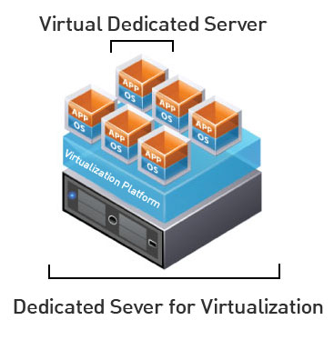
Virtual Machine Info
IP Address: 147.64.243.1##/23 (01-25)
Hostname: ecsc325-1##.cs.edinboro.edu (01-25)
Aliases:
  31##.megastuff.biz, 1##.megastuff.biz, ##.megastuff.biz (01-25)
  1##.ultrastuff.net, more?
Assignment 10 due March 26th
  Check script and upload in D2L!
Assignment 11 due April 2nd
  Check script and upload in D2L!
Accessing VM’s from off campus requires a connection to the CS VPN first,
before opening a connection to your machine!
  CS firewall prevents direct connections from other networks to our VM’s!
    Once VPN is active: ssh user@ecsc325-1##.cs.edinboro.edu

Slide 66
Virtual Hosts
http://ecsc325-1##.cs.edinboro.edu, http://147.64.243.1##
  PHP Info
http://ecsc325-1##.cs.edinboro.edu/phpmyadmin, http://147.64.243.1##/phpmyadmin
  phyMyAdmin Website
http://1##.megastuff.biz/temp/temp.php
  Temperature Graph Website
http://31##.megastuff.biz
  index.html: Hello Megastuff Website
http://##.megastuff.biz, http://1##.megastuff.biz
  TBD: Testing 123…
http://ecsc325-110.cs.edinboro.edu/awstats/
awstats.pl?config=localhost.localdomain
  AWStats
http://ecsc325-1##.cs.Edinboro.edu/squirrelmail
  Squirrelmail website
http://roundcube.##.megastuff.biz
  Roundcube webmail
http://1##.ultrastuff.net
  Ultra Modern Template Website
http://31##.ultrastuff.net
  WordPress Website
https://ecsc325-1##.cs.edinboro.edu/private
  Private web site!
https://a14.##.megastuff.biz
  Assignment 14 web site!
Replace the ## with your 2 digit number!!!

Slide 67

Linux Commands
dig
nslookup
ftp
scp
rsync
umask
yum
systemctl
chown
chmod
mysqldump
firewall-cmd
ssh
mkdir
wget
cd
echo
mv
pwd
vi
nano
mysql
rm
rpm
ls
FTP commands
  get
  put
  cd
  lcd
  pwd
  !pwd
  open
  close
  quit

Slide 68

Key Terms and Items
FTP & VSFTPd
All In One Network Routers
Firewalls & FirewallD
SSH / Reverse SSH / Proxy
Umask
SCP
Rsync
Syslog/rsyslog
Cron/crontab
Pull-based transfers
Push-based transfers
Active vs. Passive FTP Transfers
FTPS vs. SFTP
Server Message Block (SMB)
Common Internet File System (CIFS)
DFS
AWStats
Apache logging

Slide 69

For Next Class
“Rivers get connected so much stronger than expected...” –Red Hot Chili Peppers
Textbook:
  Chapter 17: FTP
Upcoming topics
  Security & Authentication
  Clouds
Finish work with VM’s
  Assignment 9 due last week!
  Assignment 10 due this week!
  Assignment 11 due next week!
Continuing work with VM’s
  Just because all tests say OK, doesn’t mean everything is working properly!
    Sometimes my check scripts have errors…
    I don’t always check for every possible entry…

